Slide 1

satellites orbiting the earth’s surface
GROUP-12
Sajid Ali Shaik
Teja Reddy Yarram
Ramana Payili
Vinson Samuel Ramalingam

Slide 2
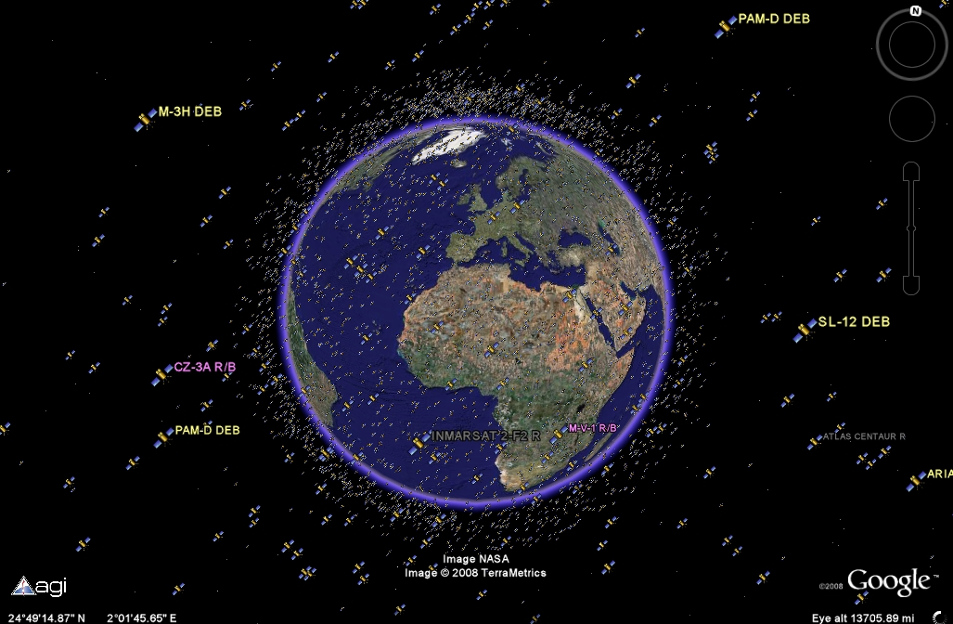
Why and how
WHY:
Importance of Satellites: Satellites are essential for communication, defense, Earth observation, and research.
Rich Dataset: The UCS Satellite Database provides detailed data on 6,718 satellites, making it a great source for creating impactful visualizations.
Interactive Insights: Static tables don’t reveal patterns well, but visualizations help users explore data interactively.
How:
Dataset Selection: We used the UCS Satellite Database, which contains details about satellite types, orbits, purposes, and more.
Data Preparation: Cleaned and structured the data to group satellites by purpose, age, and orbit type.
Visualization Design:
Stacked Bar Chart: Shows satellite ages by functionality.
Concentric Circles: Visualizes orbits and types like LEO, MEO, and GEO. Scatter Plot: Compares apogee and perigee by satellite purpose.

Slide 3
TOOLS
HTML
JAVA SCRIPT
D3JS
CSS
PYTHON

Slide 4
Visualization - 1
The stacked bar chart illustrates the distribution of satellite ages categorized by their respective functionalities.
The visualization effectively portrays the correlation between the number of satellites and their specific ages, concurrently showcasing their associated functionalities.
it can be seen from visual that oldest functioning satellite that is still orbiting the Earth was launched 44 years ago for mix use of Military and Commercial purpose.

Slide 5
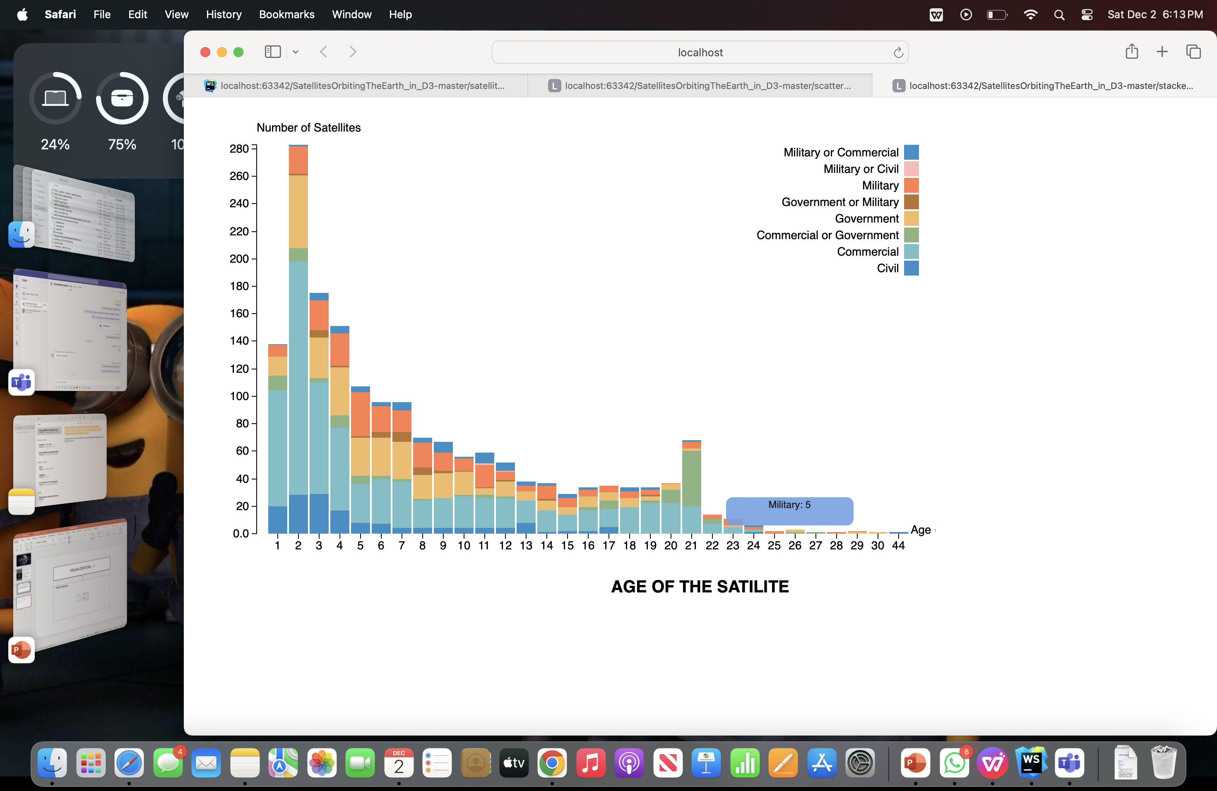
Visualization - 1

Slide 6
Visualization - 2
In visualization-2, we can get the insights related to the use of these satellites.
The concentric circles are packed with information related to the satellite in every layer.
We can observe the division of the satellite in the initial view, but when we move to the second layer, we can observe type of orbit the satellite revolves around the earth.
In the next layer we can see the orbit class of the satellites like LEO, MEO, GEO etc.

Slide 7
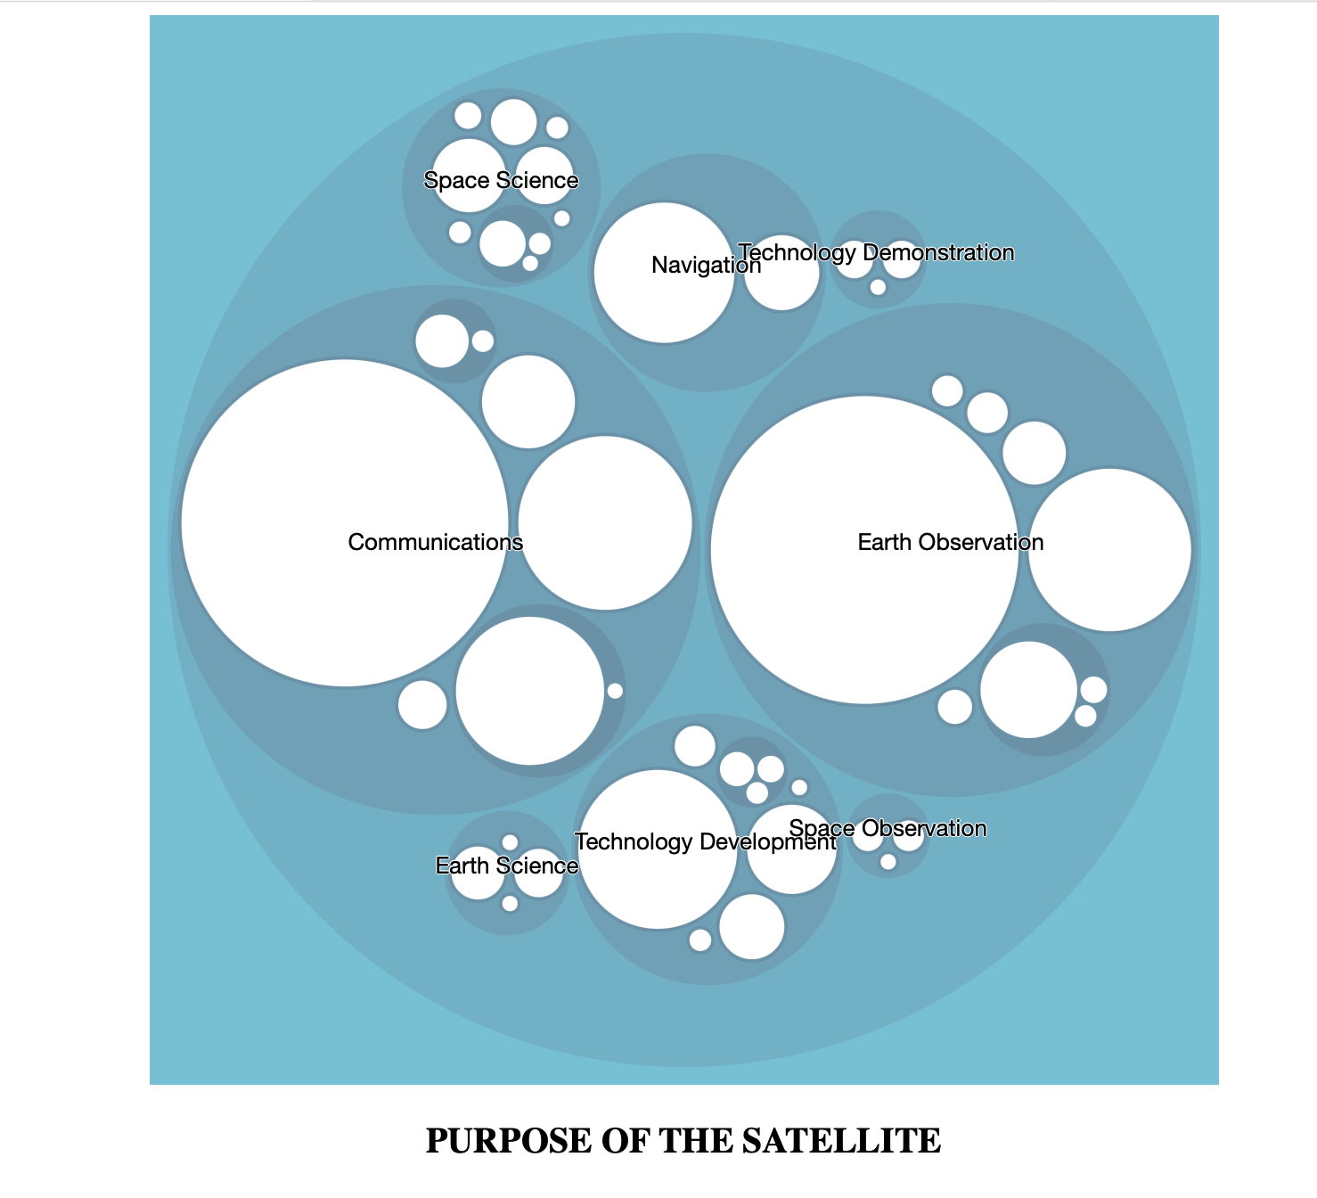
Visualization - 2

Slide 8
Visualization - 3
In this final visualization, we use the scatter plot to plot the apogee and perigee of the satellites and separated based on their purpose.
Every unique symbol represents a unique purpose of the satellite.
When hovered to a particular satellite one can understand the purpose along with the exact apogee and perigee of individual satellites.

Slide 9
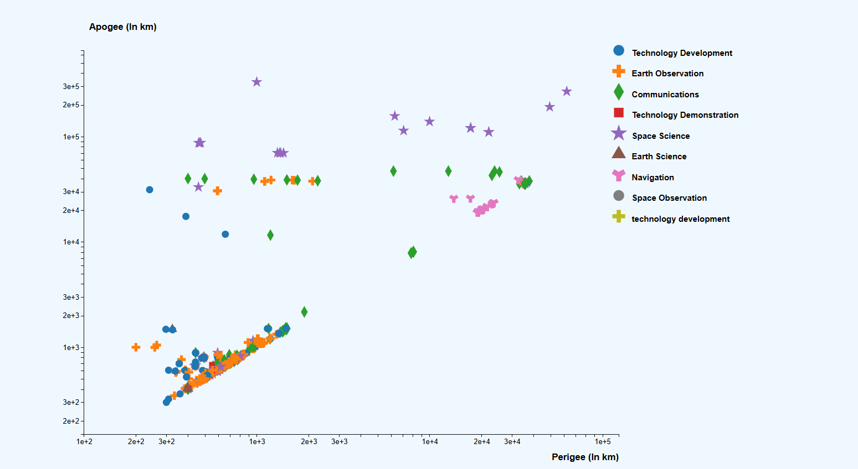
Visualization - 3
FUNCTIONALITIES

Slide 10
GOALS:
Phase 1 Goals: We aimed to create basic visualizations, understand the dataset, and explore potential design ideas. Created preliminary scatter plots and bar charts to test data visualizations. Explored D3.js for implementing interactive visualizations.
Phase 2 Goals: Built on Phase 1 by introducing interactivity and adding additional visualizations. Added tooltips for satellite details. Created advanced visuals like circle-packing diagrams for orbit classification.
Final Phase Achievements: Implemented all planned visualizations: Scatter Plot (Apogee vs. Perigee).Concentric Circles (Orbit Types).Stacked Bar Chart (Satellite Ages by Functionality).Enhanced user interaction with filters, legends, and zooming. Overcoming major obstacles like styling and selecting appropriate visualization techniques.
OBSTACLES:
- Finding the styles to our visualization is the major obstacle.
-Along with that we also faced problems while choosing the type of visualizations we need to use in order to get the best out of the data and express an exceptional story.

Slide 11
Thank you
Any questions?

